Slide 1

Analysis of TechGear Inc.
Business Data Analytics
Hananias Pizarro
September 30th, 2026
Notes:
Hello and Thank you for viewing my submission!

Slide 2

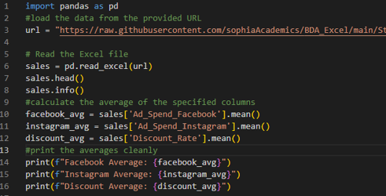
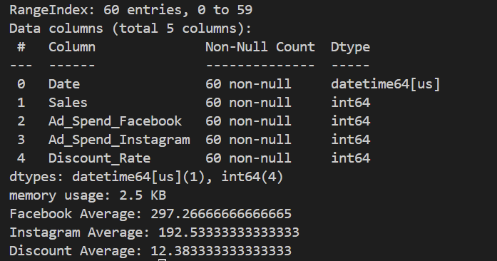
Data Overview & Key Summary Metrics
Pandas Data Frame using Python
Dataset features
Include 60 rows for a total of 5 years' worth of data
5 columns (Date is first and rest are 4 numeric variables)
No missing values leading to a clean data set
Key Insights
Average monthly Facebook ad spend: $297.27
Average monthly Instagram ad spend: $192.53
Average discount rate applied: 12.38%
Initial trends suggest heavier reliance on Facebook advertising compared to Instagram
Moderate discounting strategy indicates TechGear uses price incentives regularly but not aggressively
Results
Notes:
The dataset shows that TechGear spends significantly more on Facebook advertising than Instagram, with Facebook averaging about $297 per month compared to Instagram’s $193. This suggests Facebook is their primary marketing channel. However, to determine whether this allocation is optimal, the company should compare ad spending to actual sales performance from each platform. The average discount rate of roughly 12% indicates TechGear uses moderate, discounts to support sales. Together, these trends imply that while TechGear invests more heavily in Facebook ads and maintains steady discounting, further analysis is needed to determine whether this strategy effectively reduces sales fluctuations or whether adjustments in budget allocation or discount strategy could improve performance.

Slide 3
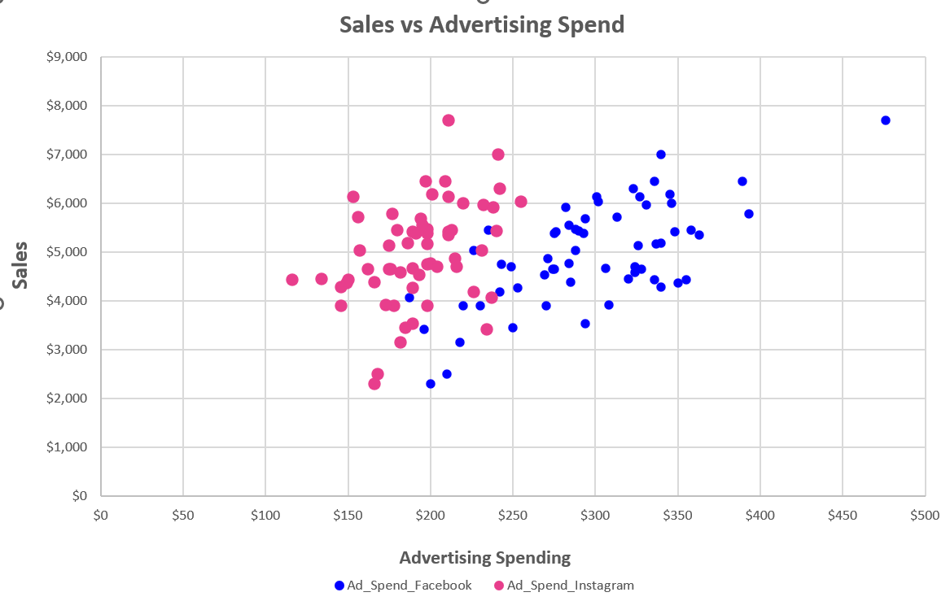
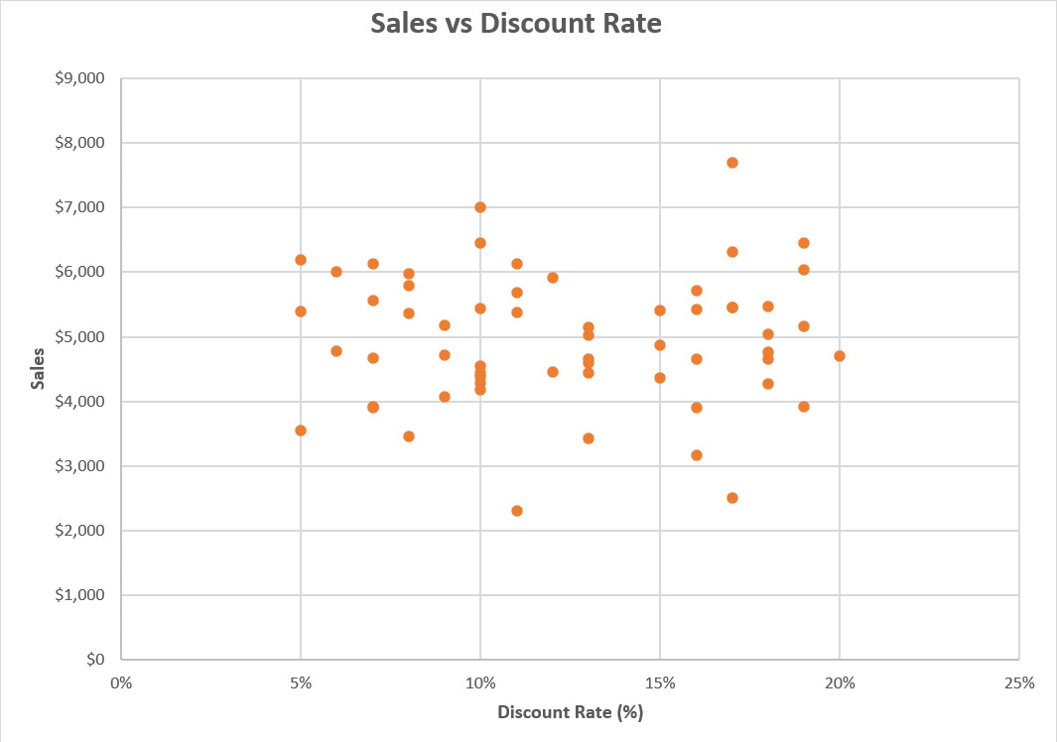
Visualizing Relationships
Advertising Spend Impact
Facebook ad spend displays a stronger and more consistent upward trend compared to In
Instagram points are more widely scattered, suggesting a weaker or less predictable impact on sales
Facebook spending reaches higher dollar levels, and those higher spends correlate with noticeably higher sales
The visual pattern suggests TechGear’s investment in Facebook advertising may be more effective at driving sales than Instagram
Discount rate Impact
Sales do not show a strong upward or downward trend as discount rates increase
Even at higher discount rates (15–20%), sales remain within the same general range as lower discount months
This suggests that discounting does not significantly drive higher sales for TechGear
Sales do not show a strong upward or downward trend as discount rates increase
Notes:
In this section, I analyzed how advertising spend and discount rates relate to monthly sales by using scatterplots. Scatterplots are the most effective choice for this type of analysis because they allow us to see the strength, direction, and consistency of relationships between two numerical variables. When looking at the advertising scatterplot, a clear upward trend appears, especially for Facebook spending. As Facebook ad spend increases, sales consistently rise, showing a strong positive correlation. Instagram spending also shows a positive relationship, but the points are more scattered, indicating weaker and less predictable returns. This suggests that TechGear’s investment in Facebook advertising is more effective at driving sales compared to Instagram. On the other hand, the discount rate scatterplot reveals a very different pattern. The points are widely dispersed with no clear upward or downward trend, meaning sales remain relatively stable regardless of whether discounts are low or high. This indicates that discounting has a limited impact on monthly sales performance.

Slide 4
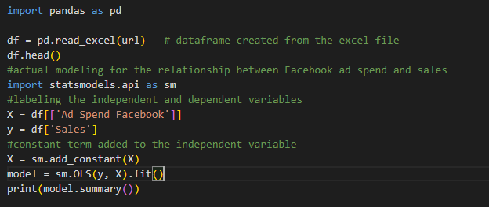
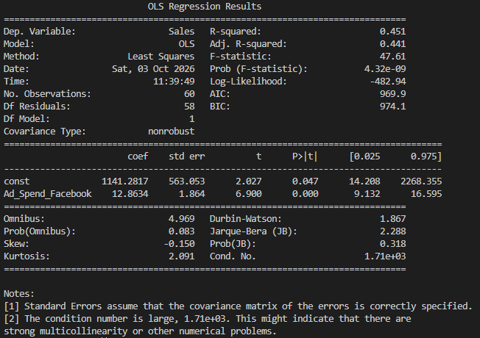
Simple Linear Regression
Model Development
Facebook ad spend as the predictor and sales as the dependent variable
Regression equation: Sales = 1141.28 + 12.86 × Facebook Ad Spend
Model created using ‘statsmodels’ OLS (Ordinary Least Squares)
Interpretation
Facebook ad spend has a positive and statistically significant impact on sales
The slope of 12.86 indicates that each additional dollar spent on Facebook ads increases sales by about $12.86
The model explains 45.1% of sales variation (R² = 0.451), showing a moderately strong relationship
Regression results confirm Facebook advertising is a meaningful driver of sales performance
Notes:
The regression results help explain how Facebook ad spend relates to sales and how well the model performs. The slope coefficient of 12.86 shows that for every extra dollar spent on Facebook ads, sales increase by about $12.86 on average, which matches the upward trend we saw in the scatterplot. The intercept of 1141.28 represents the predicted sales when Facebook spending is zero, and while it’s not the most meaningful number on its own, it’s part of the model structure. The R² value of 0.451 means that Facebook ad spend explains around 45% of the variation in sales, which is a moderately strong level of explanatory power for a simple one‑variable model. The Python output supports this interpretation because the slope is highly significant, the t‑value is strong, and the p‑value is well below 0.001, showing the relationship isn’t happening by chance, the statistics also look normal, suggesting the model is stable.The regression confirms that Facebook advertising is a meaningful driver of sales, even though other factors also contribute to the remaining variation.

Slide 5
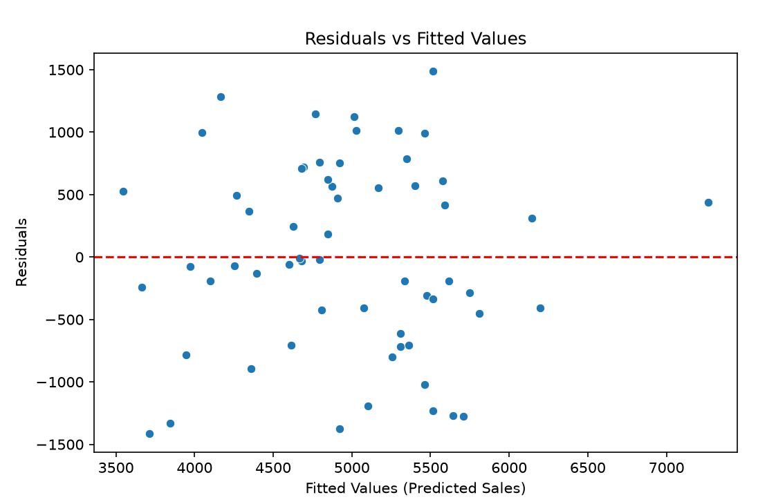
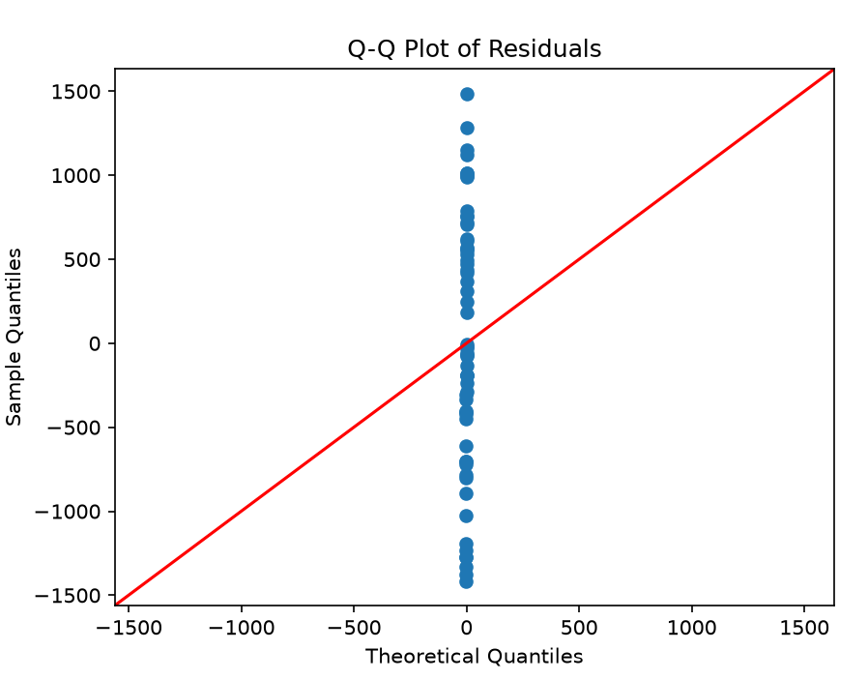
Model Fit and Q-Q Analysis
Residuals V. Fitted Interpretation
Residuals are scattered around zero, indicating the model captures the main trend
No curved pattern appears, suggesting the linear relationship is appropriate
Errors do not cluster in specific regions, supporting stable model behavior
Residual behavior indicates reasonably reliable predictions
Q‑Q Plot Interpretation
Points mostly follow the diagonal line, showing residuals are approximately normal
Small deviations at the tails are present but not severe
No strong curvature or S‑shape appears, indicating no major normality violations
Model assumptions are met, reinforcing prediction reliability
Notes:
The two plots help show how accurate and reliable the regression model is. In the residuals vs fitted plot, the points are scattered randomly around the zero line, which means the model isn’t consistently over predicting or under predicting sales. There’s no clear pattern or funnel shape, so the errors stay fairly consistent across different predicted sales levels. This suggests the linear model is doing a good job capturing the main relationship. The Q Q plot also supports the model’s reliability because most of the points fall close to the diagonal line, showing that the residuals are roughly normally distributed. Since both plots look the way they should, the model meets the key assumptions of linear regression and its predictions can be considered reasonably trustworthy, even though it doesn’t explain all of the variation in sales.

Slide 6
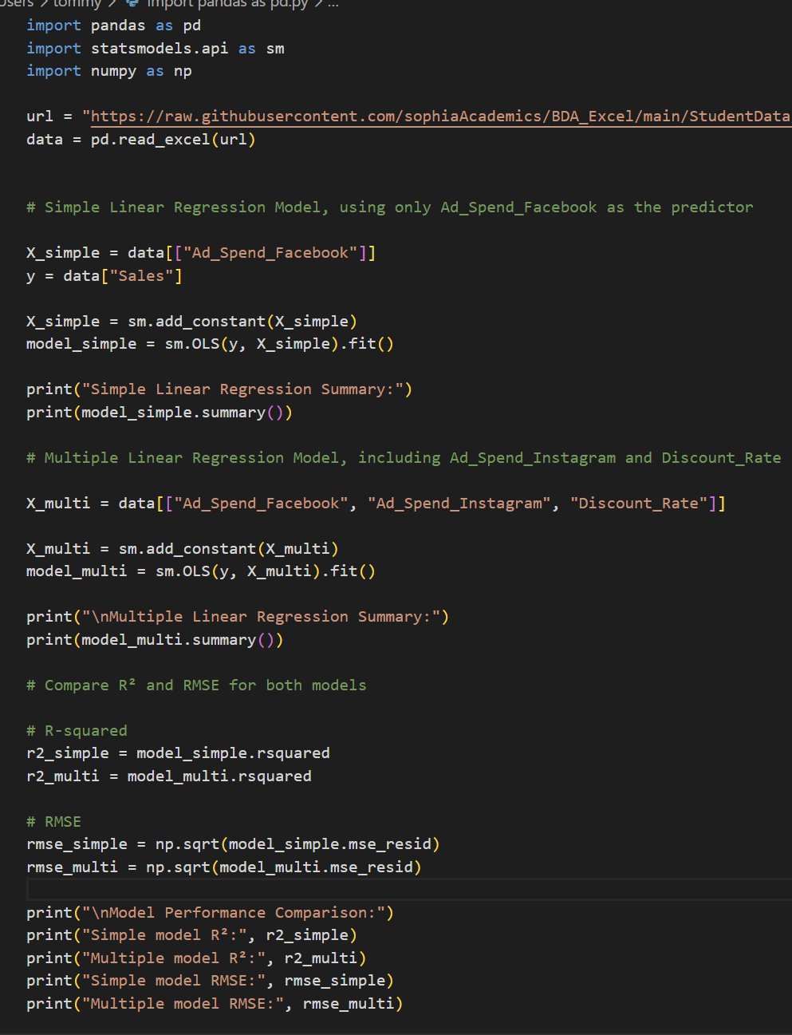
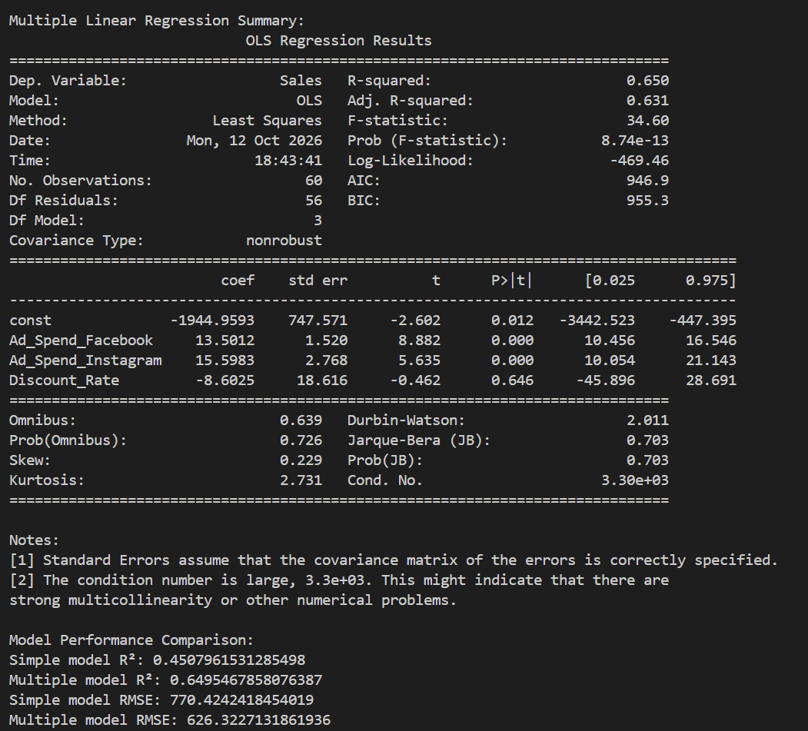
Multiple Linear Regression
Notes:
Python code and printed results when ran. Analysis on next slide.

Slide 7
Multiple Linear Regression Analyzed
Multiple Vs Simple Linear Regression
Multiple Regression results account for 65% of sales variation while simple is only 45%
Multiple regression has a lower RSME, indicating more accurate sales
Multiple Regression provides a cleaner picture on how advertising impacts sales
Key Takeaways
Facebook & Instagram ad spend both have strong positive effects on sales
Instagram shows an even larger impact when included with Facebook
Discount rate does NOT meaningfully change sales outcomes
Sales are influenced more by advertising activity than by discounting
Notes:
In the multiple linear regression model, both Facebook and Instagram ad spend have strong positive coefficients, which means increases in either platform’s advertising are linked to higher monthly sales. Instagram shows an even larger effect than Facebook, suggesting it plays a major role when both channels are considered together. The discount rate has a small negative coefficient and is not statistically significant, so discounts do not reliably change sales. Compared to the simple linear regression model, which only used Facebook ad spend, the multiple regression model performs better because it explains more of the variation in sales and has a lower RMSE. This shows that including Instagram and discount rate gives a more complete and accurate picture of what drives TechGear’s sales, making the multiple regression model the stronger choice for decisions.

Slide 8

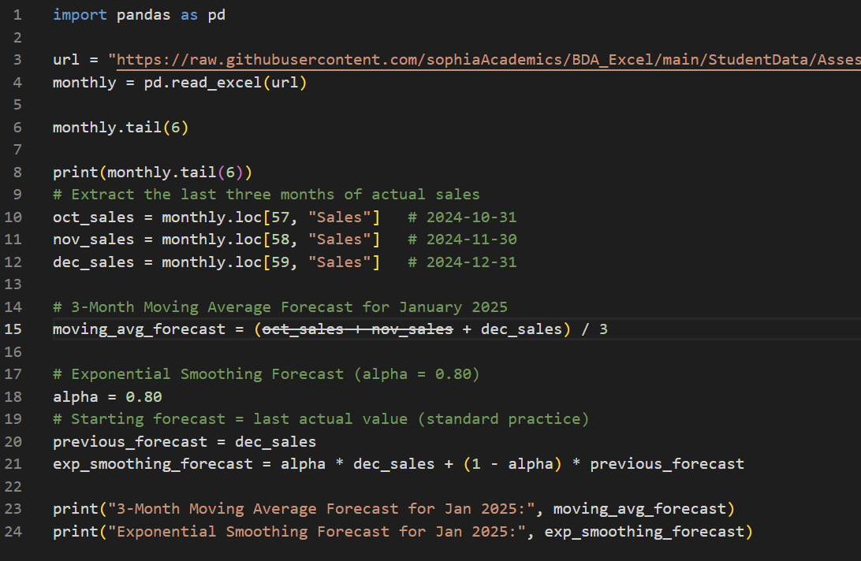
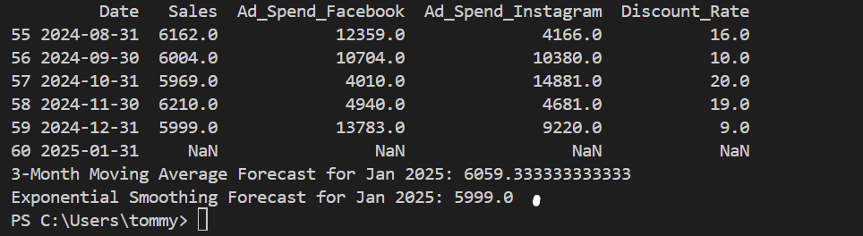
Forecasting
Forecast Results
3-Month moving average forecast for January 2025 is 6059.33
Exponential smoothing forecast is 5999.00 (Smoothing parameter of .80)
Moving Average give a smoother estimate based on previous 3 months
Exponential smoothing has stronger reaction to the most recent month
What’s More Reliable?
Since the company prefers forecasts that emphasize recent sales trend exponential smoothing is more reliable
The smoothing parameter of .80 gives more weight to Dec. Sales making forecast more responsive
If wanting for long term stability/ use, then moving average is preferable

Slide 9
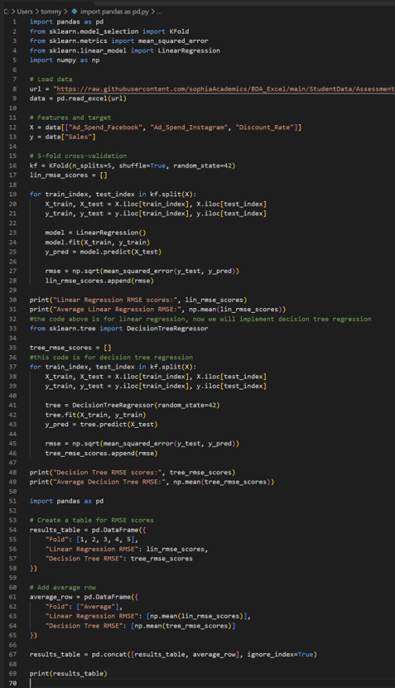
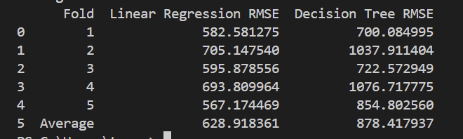
5-fold cross-validation Code & Results
Multiple linear regression and Decision Tree

Slide 10

RMSE Comparison & Model Selection
Linear Regression has a lower average RMSE than decision tree
Decision Tree shows higher error and more validation across folds
Liner Regression is better model for TechGear since lower RSME
Analysis of Predictive Models
Key Insights
Predicted sales of 4200 fall well below the 6500 profitability requirement
Actual sales may range from about 3571 to 4829 based on RMSE
Even the upper end of the range does not reach the profit threshold, indicating High loss risk
Model emphasizes the need for stronger advertising or cost adjustments
Notes:
I chose the linear regression model because it had the lowest average RMSE, which means it predicts monthly sales more accurately than the decision tree. The RMSE of about 629 shows how much actual sales might differ from the prediction. With a predicted value of 4200, the RMSE suggests actual sales could fall between roughly 3571 and 4829. Since TechGear needs at least 6500 to stay profitable, even the high end of that range is still below the threshold. This makes the forecast risky and shows that TechGear may need to adjust its marketing or spending to avoid falling short.

Slide 11
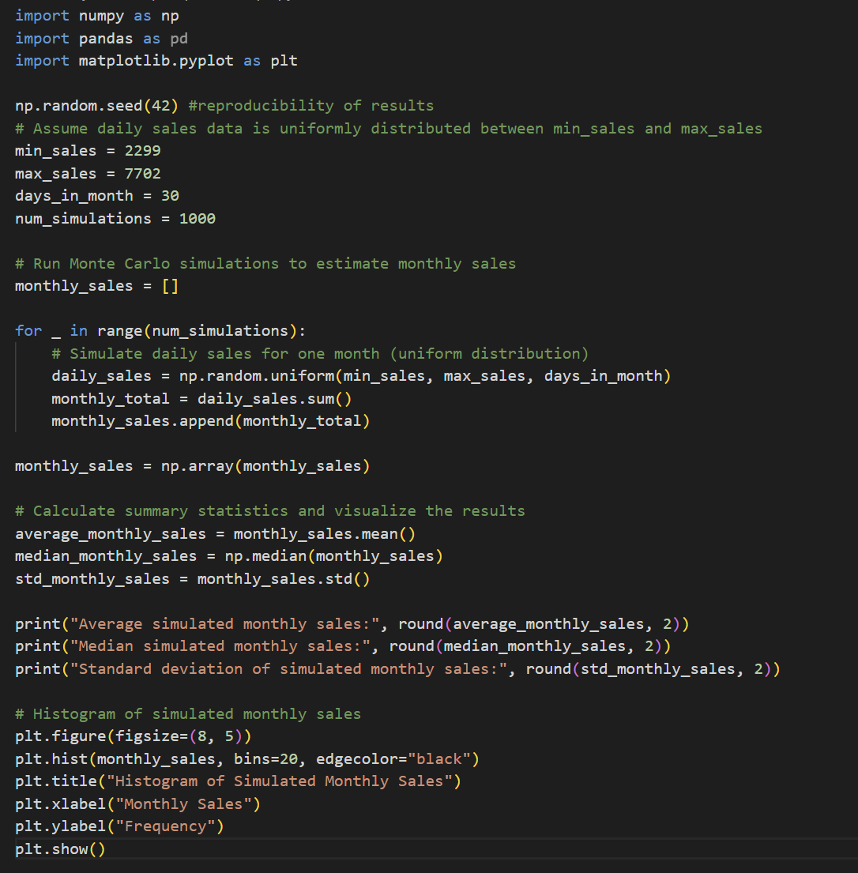
Monte Carlo Simulation Setup & Code
Simulated 1,000 months of using daily sales using a uniform distribution of 2,299 – 7,702
Summed 30 simulated days to generate one monthly total
Simulation models uncertainty in future monthly sales
Notes:
On this slide, I’m showing how the Monte Carlo simulation was set up. I used daily sales values that were randomly selected between 2,299 and 7,702, since that range represents TechGear’s minimum and maximum daily sales over the past 60 months. Each simulation creates 30 random daily values and adds them together to form one possible month of sales. I repeated this process 1,000 times to capture a wide range of possible outcomes while using the seed value of 42. The code here shows exactly how the simulation was built and how the daily randomness feeds into the monthly totals.

Slide 12
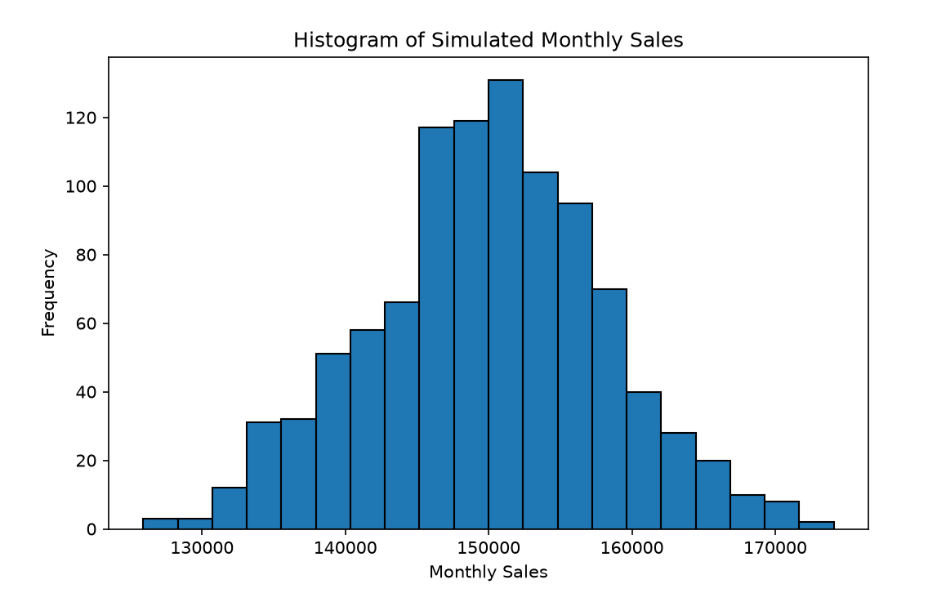
Simulation Results
Average simulated monthly sales: 149946.91
Median simulated monthly sales: 150118.2
Standard deviation of simulated monthly sales: 8101.09
Histogram shows the distribution of all simulated monthly sales outcomes, some fall noticeably lower or higher
Bell shaped distribution centered at the average monthly sales around 150,000
Standard deviation of 8,101 shows how monthly sales are not stable, showing that TechGear faces meaningful volatility in its revenue
Budgeting should account for lower‑end months to avoid overspending
Operational decisions (inventory, staffing, and cash flow) should reflect this volatility, and TechGear should keep wiggle room around the ~150,000 average to handle months that fall several thousand below it.
Notes:
Looking at the results, the histogram displays the distribution of all 1,000 simulated monthly sales totals, and most of the values cluster around the middle. The average simulated monthly sales are about 149,947, and the median is around 150,118, which means the typical month falls near 150,000. The standard deviation is about 8,101, which shows that monthly sales can shift by several thousand dollars in either direction. That level of variability is important because it tells TechGear that sales aren’t perfectly stable month‑to‑month. They should keep some wiggle room around the 150,000 average so they’re prepared for months that fall noticeably below it. These insights help TechGear plan more accurately for budgeting, inventory, and forecasting by basing decisions on the full range of possible outcomes instead of relying on a single number.

Slide 13
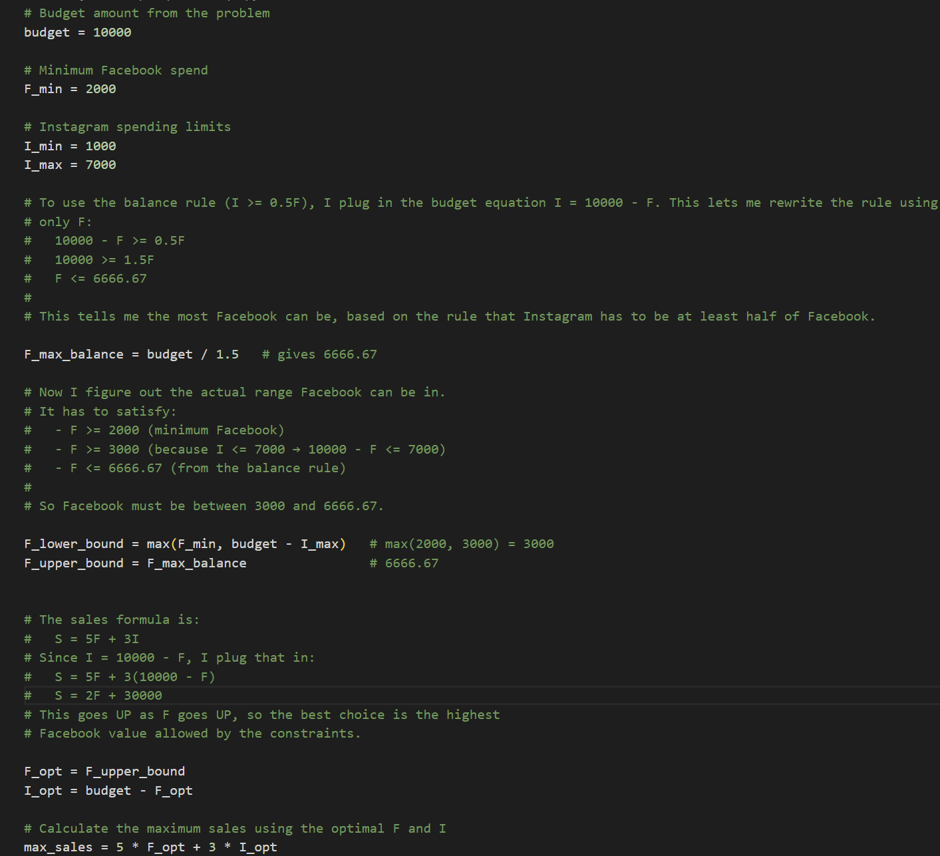

Maximizing Advertising Budgeting
Optimal Budget Allocation
Facebook budget : $6,666.67
Instagram Budget: $3,333.33
Instagram is equal to 50% of Facebook spend
Maximum Achievable Sales
Monthly Sales = $43,333.33
By pushing Facebook spend to highest feasible value
Uses full budget of 10,000
Notes:
The optimal allocation for TechGear’s advertising budget comes from applying all the spending rules and the balance requirement between Facebook and Instagram, and the linear programming model shows that the best split is about $6,666.67 on Facebook and $3,333.33 on Instagram. This combination uses the full $10,000 budget and meets every constraint, including the rule that Instagram spending must be at least half of Facebook’s. We reached the maximum achievable sales by substituting the budget into the sales equation and seeing that total sales increase as Facebook spending increases, so the model pushes Facebook to its highest allowed value until the balance rule stops it. With this allocation, TechGear can generate roughly $43,333.33 in monthly sales, which aligns with business goals because it gives them the strongest return on their advertising investment while still keeping their marketing presence balanced across both platforms.

